Slide 1
Develop and Deploy
A Module in Agile Fundamentals
Notes:
Plan, execute and report on Agile projects
--------------------------------------------------------------------------------------------------------------------
Welcome to the module Planning the Project. This module is brought to you by ThoughtWorks Studios, maker of Mingle, Cruise, and Twist.
In this module, we’ll explore the practices that help Managers and Project Managers plan, execute, and report on Agile projects.

Slide 2
Iteration Planning
Notes:
We’ve planned our project into Releases and we are ready to get started.
How to manage the everyday
Some of this you’ve seen in previous modules
----------------------------------------------------------------------------------------------------------------
So now that we know what we’re going to build, and in what order, we have to figure out how to make sure that everything flows nicely through the process.
Much of what we’re going to talk about now has been covered in earlier modules. Since it’s important to have a firm understanding of these things, we’ll go over them again here.

Slide 3
Iteration planning: input
Development Capacity (Velocity)
Release Plan
Prioritized Story Backlog
Story owners/Domain Knowledge
Iteration Theme
Original stories
New stories
Defects
Hangover stories
Stories
Capacity
Theme
Iteration
Planning
Notes:
Planning for the next immediate iteration should be detailed and may even pre-task out stories.
Rolling look ahead planning – Mike Cohn – looks out 3+ iterations. Planning for cross team dependencies, distributed dependencies, etc.
Iterations should not change once started. Wondering about this bullet?
Stories can be pulled in if all work is complete, but stories should not be changed mid iteration.
----------------------------------------------------------------------------------
Iteration Planning is never done in isolation: it exists within the larger context of the Release Plan. But whereas a release plan should change infrequently during a project, the natural ebbs and flows of software development means iteration plans will be in a fairly constant state of flux, with stories often coming in and going out of iterations until just prior to iteration commencement. The PM and IM alike need to understand the fluid nature of iteration plans and be prepared to defend teams from interference from changes to iteration content or competing priorities outside the team commitments.
Other items which could be input into Iteration Planning are:
any extra constraints on capacity (e.g., a short iteration due to public holidays or developer leave)
changes to process due to previous retrospective output
ALL STORIES must be ready for development – including narrative – and estimated
Low: 1 min
High: 3 min

Slide 4
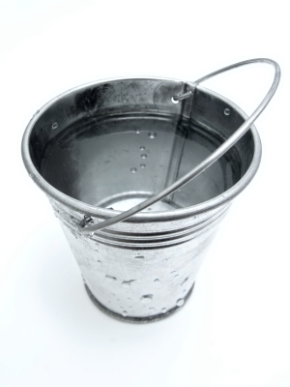
Iteration Capacity Planning
Paid time off
Holidays
All-hands meetings
Is it math, or is it more complex/subtle?
Or
Notes:
Iteration Capacity Planning is the work an iteration manager does to determine whether any out-of-the-ordinary events will impact the team’s velocity, so that the team can adjust its iteration commitment appropriately.
It is an art, not a science. In the end, it’s the team’s role to commit to what they think they can deliver. Capacity planning simply helps to provide guidance to the team.
If BA or Tester is going to be gone, accommodate for the loss:
Expect to have less narratives complete for a specific iteration. Plan for technical stories then
Have the customer or testers help create a larger backlog of narratives
Have devs or BAs help with testing, writing tests, etc
Low: 1 min
High: 2 min

Slide 5
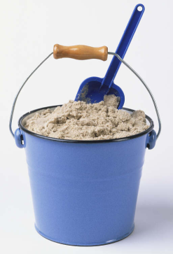
The basics of iteration planning
No
Has
capacity been exceeded?
Update
story
backlog
Determine development capacity
Add “next”
story from backlog to plan
Yes
Socialize plan
vs.
Notes:
As usual, the devil is in the details and choosing the “next” story can be the difference between an average and high performing team. The major barrier to the “next” story being just the next one on the master story list (MSL) is often dependencies or story size.
It’s important to note that filling an iteration does not require exactly the correct number of points scattered across the cards selected. Given the lack of precision around estimates, being one point over or under is not going to have a big impact on the result. Conceptually this is the difference between filling a bucket of water (where no excess can be contained) and filling a bucket of sand (where a little extra sand is permissible). Neither solution is going to guarantee all the work will be done however. Comfortably uncomfortable.
DISTINGUISH between Iteration Planning and Iteration Planning Meeting – there are things that need to be done before the IPM, and things to be done in the IPM
Low: 2 min
High: 4 min

Slide 6
The life of a story across iterations
I0
I1
I2
I3
Planning
Planning
Planning
Elaboration
Elaboration
Elaboration
Build
Build
Build
I1 Activities
UAT Test
UAT Test
UAT Test
I2 Activities
Regression Test
Regression Test
I3 Activities
Notes:
For many people accustomed to single activity workflows, understanding the dynamics of an iterative project can be challenging. This diagram attempts to make a clear statement about the timing and nature of activities being conducted at any one time. The items of the same color are all activities required for a single development iteration, which requires planning and story elaboration (in the previous iteration), development and UAT (in the current iteration) and then regression testing (starting in the subsequent iteration.
And this set of tasks overlap for each iteration, so that at any point in time (looking down a vertical slice of the diagram), planning will be being done for the next development iteration, development and UAT will be in progress for the current development iteration and regression testing will be conducted for the previous development iteration.
Low: 1 min
High: 3 min

Slide 7
Iteration planning: output
Commitment
Updated story wall
Understanding of risks
Understanding of theme
Updated estimates
Capacity
Stories
Theme
Iteration
Planning
Notes:
Much like the Project Charter, the iteration plan (usually visible on the story wall) is the most tangible output of the iteration planning process, but the real value is having the team understand, agree to and sign up to the objective of delivering the iteration. This understanding is predicated on knowing the development capacity, the details of the stories to be implemented and the risks associated with these stories.
As iteration planning is also an activity that delivers no business value, emphasis should be on keeping the planning meetings as short as possible.
Note: although updated estimates is listed as an output above, this should only be the case if new understanding has revealed previous estimates are no longer accurate in terms of their relativity, not their absolute value. The mechanics of Agile estimation is beyond the scope of this course though.
Low: 2 min
High: 4 min

Slide 8

Module Acceptance Criteria
Learn how to manage the work
Understand the different types of meetings
Learn about the flow of the iteration
Understand how to use information radiators

Slide 9
Acceptance Criteria
The Context: Given…
The Event: When…
The Outcomes: Then…
Given that the user is not logged in
When the user clicks on the Shopping Cart link
Then they should be required to log in
Reference: Dan North’s Blog @ http://dannorth.net/introducing-bdd
Notes:
Inception level vs. Iteration level criteria
Inception - I’ll know this is complete when …… [CLICK]
Iteration Level…
Given – preconditions to the story. State of the system, object, role [CLICK]
When – the action[CLICK]
Then – the result
Gives context for estimating
Security is a good example.
I’ll know this is complete when each role logs in and they receive the proper access or not.
vs. each role spelled out in the Narrative as a separate Given, when then statement.
When each statement is fulfilled, the story is done
-------------------------------------------------------------------------------------------------------------------------------
Now that we have a story, we need to address that Testable attribute. We do this by defining the acceptance criteria. That is, we identify those criteria which, when met, allow us to assert that the story has been completely and successfully implemented.
While there are many ways to phrase or write the acceptance criteria, we prefer the scenario template devised by Dan North and Chris Matts, and first documented in an article by Dan published in Better Software magazine in March of 2006. You can read it on Dan’s blog at dannorth.net/introducing-bdd as you’ll see on the slide.
The template has three clauses, like the user story template. In this case, they specify…
[CLICK] the initial context, using the keyword “given”. This clause identifies the pre-existing conditions that must exist before we can execute or experience…
[CLICK] the event, or action, which is specified using the “when” keyword. Finally, we specify…
[CLICK] the outcomes or expectations using the “then” keyword. Here’s an example…
[CLICK] First, the context – the user must not be logged in. Note that the Given – the context – is NOT part of the test, but rather is the set-up. That is, in this case we assume that the ability to log in and the permissions associated with that logging in have been dealt with elsewhere. This particular scenario is focused on verifying that a user is required to log in before being able to click on the Shopping Cart link. It is not focusing on whether or not it is possible to log in.
Once the context is set up, then we have the specific event, or behaviour, that is executed. This is the action in the test. In this case, the action is to click on the Shopping Cart link.
Finally, the scenario specifies one or more outcomes. In this case, the user should be required to log in. This might more properly be written “a login form is presented to the user” since that is measurable.
It’s important to note that there may be multiple parts to the Context – the Given clause – and to the Outcomes – the Then clause – but there will normally be only a single part to the Event – the When clause.
The acceptance criteria should be written so that they are executable, preferably in code.
We’ll talk about when to add the acceptance criteria to a story later in this module.

Slide 10
Managing the Work
Notes:
We’ve planned our project into Releases and we are ready to get started.
How to manage the everyday
Some of this you’ve seen in previous modules
----------------------------------------------------------------------------------------------------------------
So now that we know what we’re going to build, and in what order, we have to figure out how to make sure that everything flows nicely through the process.
Much of what we’re going to talk about now has been covered in earlier modules. Since it’s important to have a firm understanding of these things, we’ll go over them again here.

Slide 11
The life of a story across iterations
I0
I1
I2
I3
Planning
Planning
Planning
Elaboration
Elaboration
Elaboration
Build
Build
Build
UAT Test
UAT Test
UAT Test
I1 Activities
Regression Test
Regression Test
I2 Activities
I3 Activities
Notes:
For many people accustomed to single activity workflows, understanding the dynamics of an iterative project can be challenging. This diagram attempts to make a clear statement about the timing and nature of activities being conducted at any one time. The items of the same color are all activities required for a single development iteration, which requires planning and story elaboration (in the previous iteration), development and UAT (in the current iteration) and then regression testing (starting in the subsequent iteration.
And this set of tasks overlap for each iteration, so that at any point in time (looking down a vertical slice of the diagram), planning will be being done for the next development iteration, development and UAT will be in progress for the current development iteration and regression testing will be conducted for the previous development iteration.
Low: 1 min
High: 3 min

Slide 12
A sample iteration schedule
Week 1 … Week 2
Stand-up
Stand-up
Stand-up
Stand-up
Stand-up
Stand-up
Design
discussions
Analysis meetings
Development
Analysis
Analysis meetings
Design
discussions
Showcase
Prep
Stand-up
Development
Analysis
Development
Analysis
Development
Analysis
Development
Analysis
Showcase
Retrospective
Iteration
Planning
Wednesday
Thursday
Friday
…
Friday
Monday
Tuesday
What’s missing?
Notes:
Rookie error to start iteration on Monday. Too many holidays.
No standup on first morning of iteration
Glaring omission is ongoing testing
2 – 4 weeks is a normal length.
It’s a rookie error to start an iteration on Monday and finish it on a Friday. After all, it seems logical given the natural week boundaries. However, the number of public holidays that eat into Friday and Mondays can cause major headaches when it comes to re-scheduling showcase meetings and the like.
This schedule shows a common pattern of no standup on the first morning of a new iteration. As everyone’s context has switched since the end of the previous iteration, there’s normally very little continuity and makes stand-ups on these mornings of little value, especially once a team is up to speed.
The one glaring omission from this diagram is the ongoing testing effort required by the QA people. They will be doing spot inspections, regression testing and (possibly) automation for the majority of the iteration whilst development and analysis is going on.
Two to four weeks is a normal length for an iteration. It is a nice balance between setting a regular pace for the team and having enough time to deliver something demonstrable. If you feel the need to consider a longer iteration because the requirements are simply too big to get done properly within 2 weeks, then the size of the requirements is almost definitely the issue, not the size of the iteration.
Low: 2 min
High: 4 min

Slide 13
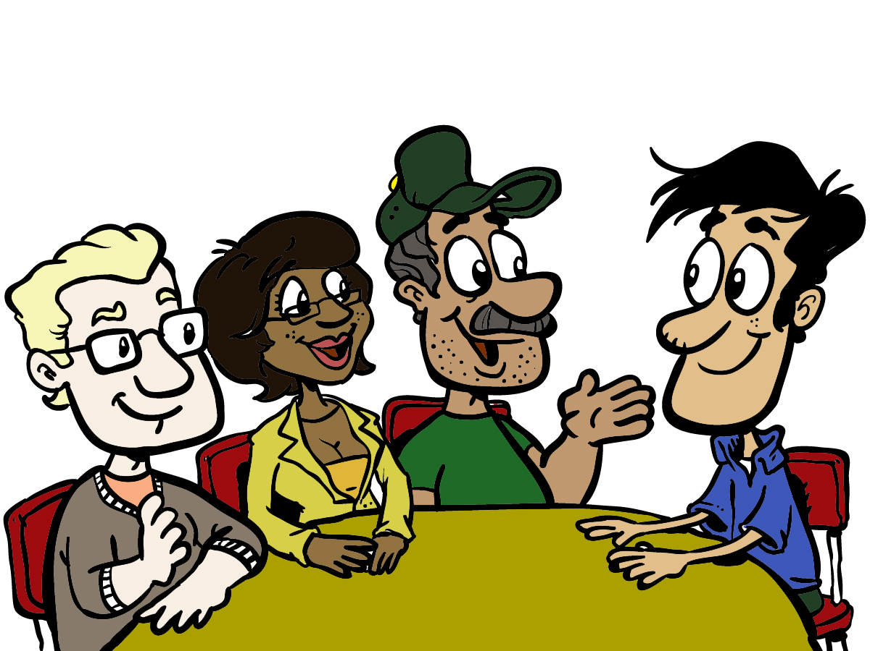
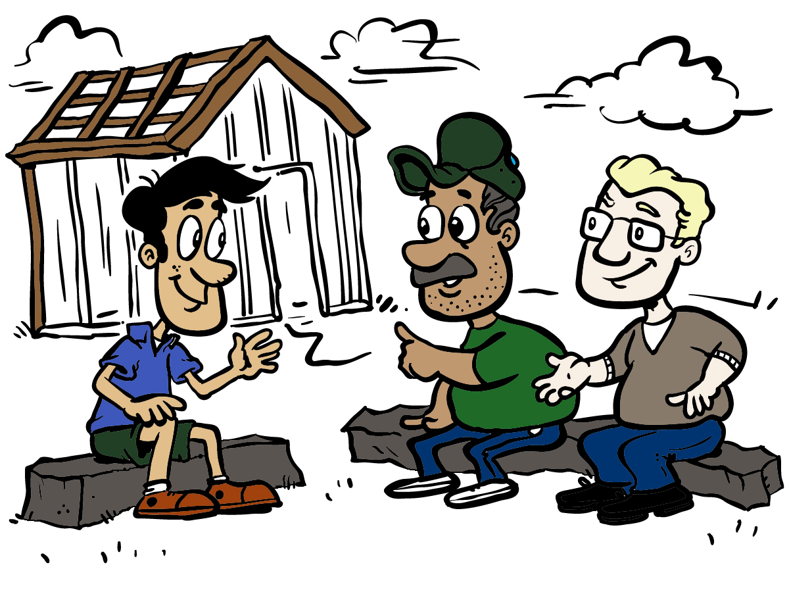

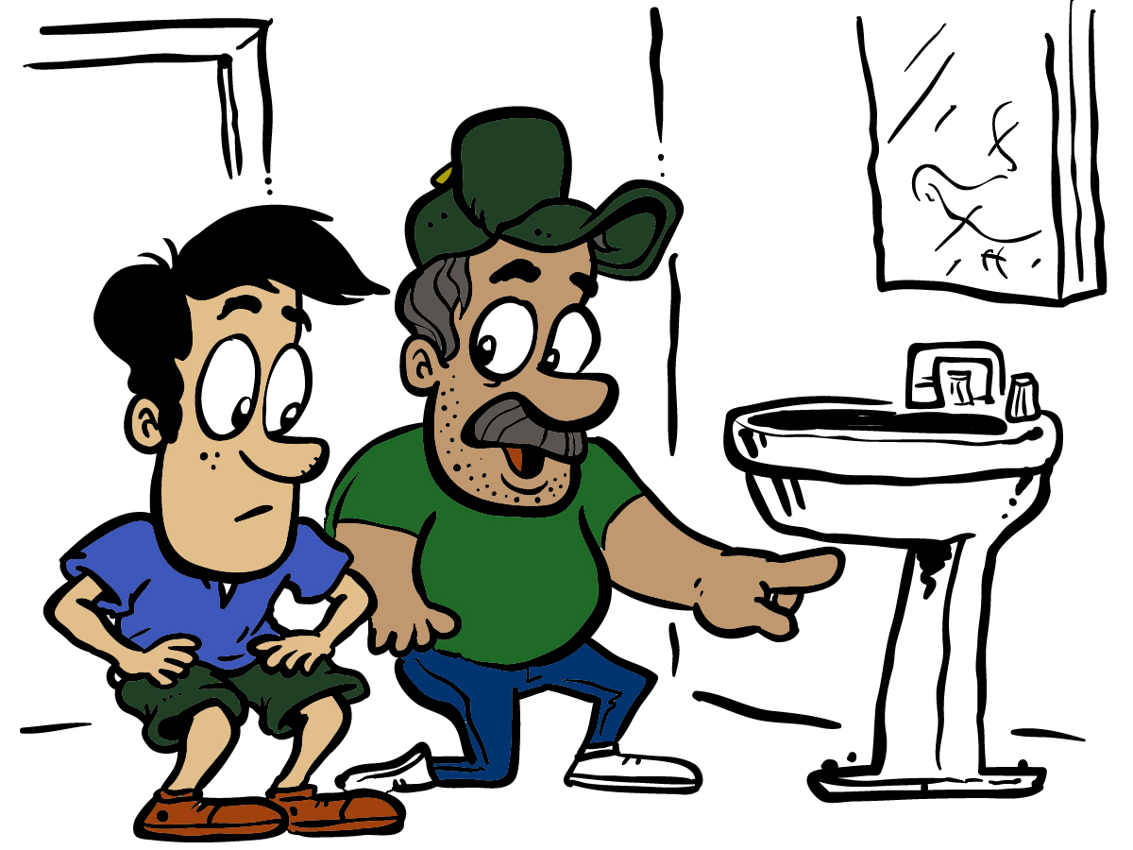
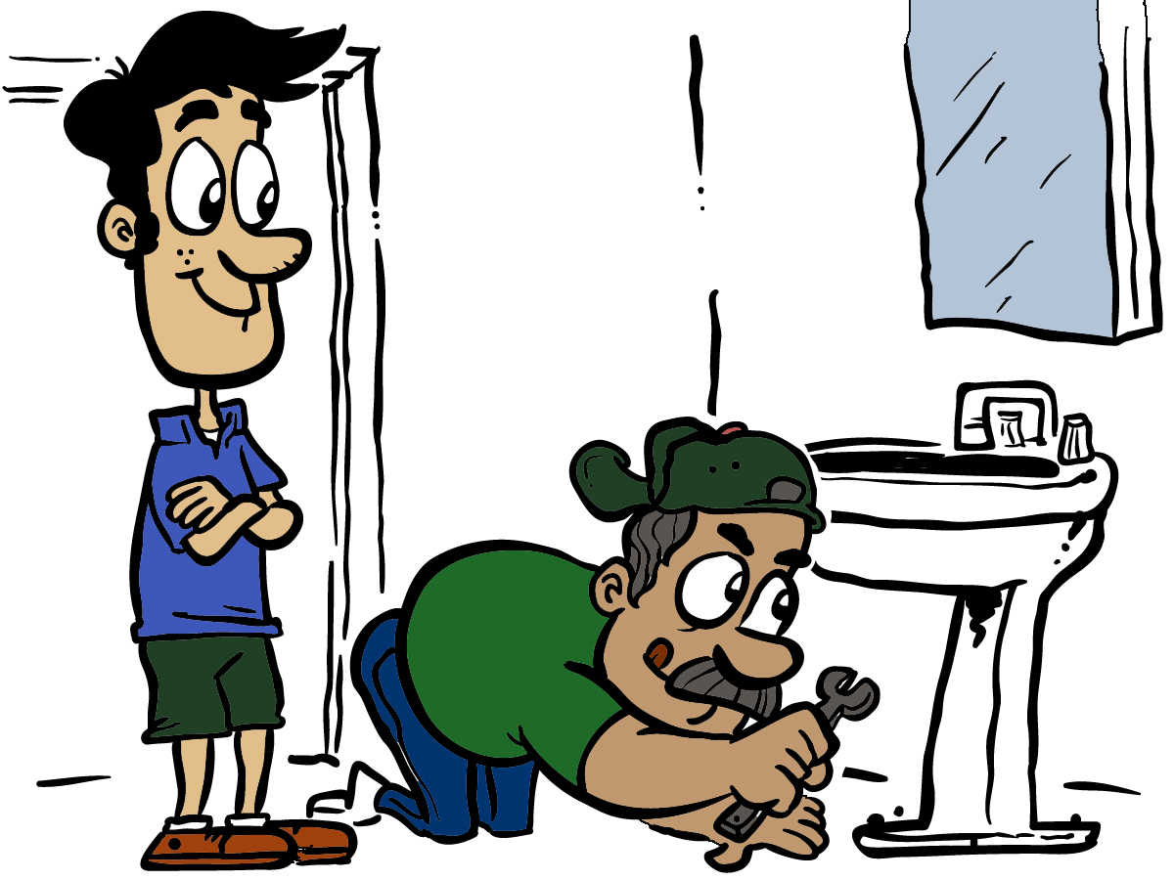
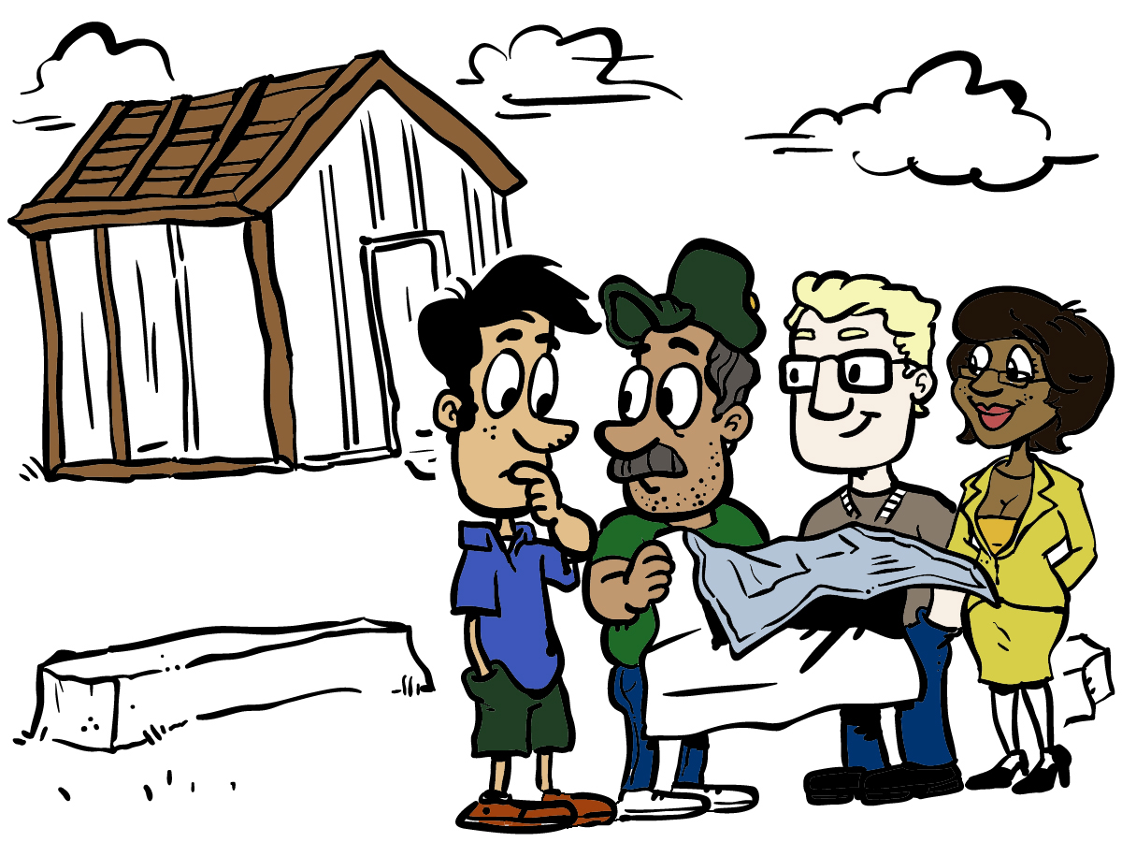
Iterative and Incremental
Notes:
Iterative
Define a set of steps and do them repeatedly.
Lather, rinse, repeat
Analyze, design, build, test, show, review, improve
Incremental
Adding more each iteration
-------------------------------------------------------------------------------------------------------------
In the Module “The Agile Core,” we talked about the fact that Agile, by nature, is iterative and incremental. To make sure we have a shared understanding of those terms…
By “iterative”, we mean that we define a set of steps, and then we do that set of steps repeatedly. Like the instructions on a shampoo bottle – “lather, rinse, repeat”. We figure out what works for us, and then we do that repeatedly. Of course, we’re constantly examining and re-evaluating what we’re doing, looking for ways to improve.
By “incremental,” we mean that with each iteration – each timebox of effort and product – we add something more to the functionality and value of the thing we’re building. We don’t define how “big” the increment is, we just make sure that each time around, we’re delivering something more.

Slide 14
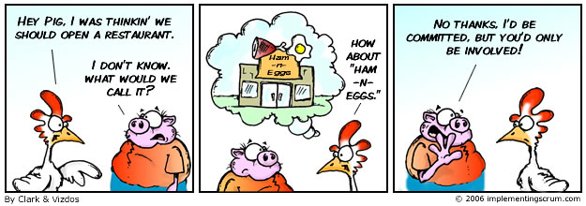
Pigs and Chickens
From http://www.implementingscrum.com/2006/09/11/the-classic-story-of-the-pig-and-chicken/
Notes:
[PAUSE TO LET THEM READ]
Message
Some folks are totally committed – pigs
Others involved, interested, provide input, but not committed - chickens
--------------------------------------------------------------------------------------------------------------
Lots of folks have heard about pigs and chickens, but not everyone knows where that usage came from. Here’s a little comic strip from implementingScrum.com that tells the story.
[PAUSE TO LET THEM READ]
Regardless of how you feel about pigs and chickens, the message that has become a part of Agile culture is that there are some people on a project who are totally committed – the pigs. Then there are folks who are involved, interested, and even have input, but are not totally committed – the chickens. Both groups contribute, and both are important. The distinction is that the pigs will live or die according to the success of the project.

Slide 15
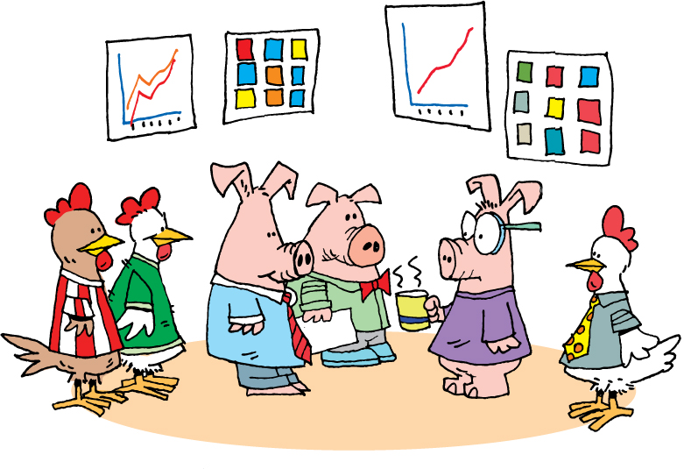
Daily Stand-Up
Notes:
Daily Scrum or daily standup
Chickens and pigs – who talks, who doesn’t
Held daily
Entire team
Answer 3 questions
What did you do yesterday?
What are you going to do today?
What obstacles or impediments are preventing you from making progress?
Short
Conducted by the card wall
Everyone stands
Keeps everyone informed
Not a status meeting
--------------------------------------------------------------------------------------------------------------
Whether you talk about Scrum – and call them daily scrums – or XP – and call them daily stand-ups – the concept is common to both systems. The idea is that the project team gets together daily, stands up, and each committed member of the team (the pigs) shares the answers to these three questions:
What did you do yesterday?
What are you going to do today?
What obstacles or impediments are preventing you from making progress?
Generally speaking, these meetings should be pretty short. Team members will frequently refer to stories by number or title, like “I completed number 421 yesterday and am going to start on number 437 today. I can’t get going until the database is set up.”
Since the card wall - whether physical or electronic - is readily available and visible, generally it’s easy for everyone to understand what is being discussed.
The meetings are held standing, because the goal is to keep them short. Anything that doesn’t fit easily into the answer to one of the questions is recorded and discussed at the end of the stand-up meeting. Chickens are generally not permitted to speak during stand-up, as what they have to say may be important and valuable, but is not a part of this particular meeting.
The daily stand-up, or daily scrum, contributes significantly to keeping all parties informed about what’s going on and what progress is being made.
The daily stand-up is not a status meeting. It is not an opportunity for everyone present to report to the project manager, scrum master, or anyone else. The daily stand-up is a chance for everyone to keep up to date with what is going on on the project.

Slide 16
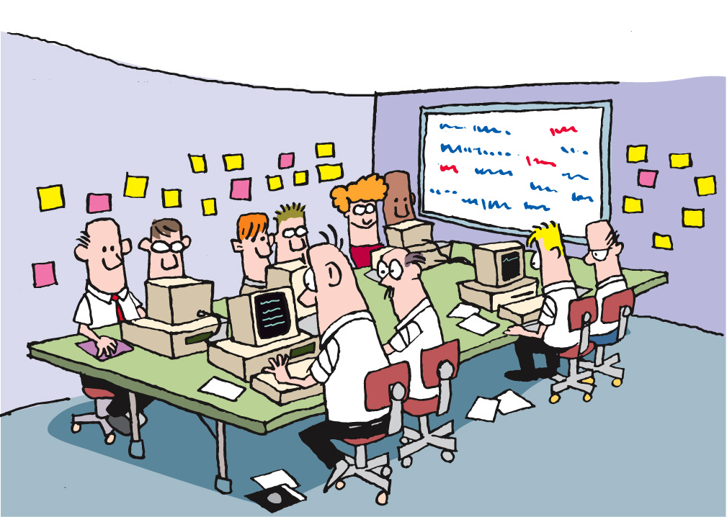
Team Room: Open Conversations
Notes:
Ideally everyone is collocated
PM/IM
DB
Business/Customer
Part time folks should have standard hours in the team room
--------------------------------------------------------------------------------------------------------------------
Part of the flow of your project is the flow of communication. Having a collocated team means that they are able to talk with each other easily. This eliminates the cost of tracking someone down when you need them, ensures that knowledge and experience gets freely shared among the members of the team, and increases the cohesion of the team.
Remember our discussion of context switching and lost time in the module The Agile Core? The collocated team addresses these and other issues by keeping everyone in close proximity. When you combine the time savings, the osmotic learning that takes place, and the ease of collaboration, we find that having a collocated team plays a significant role in contributing to the success of agile teams.

Slide 17
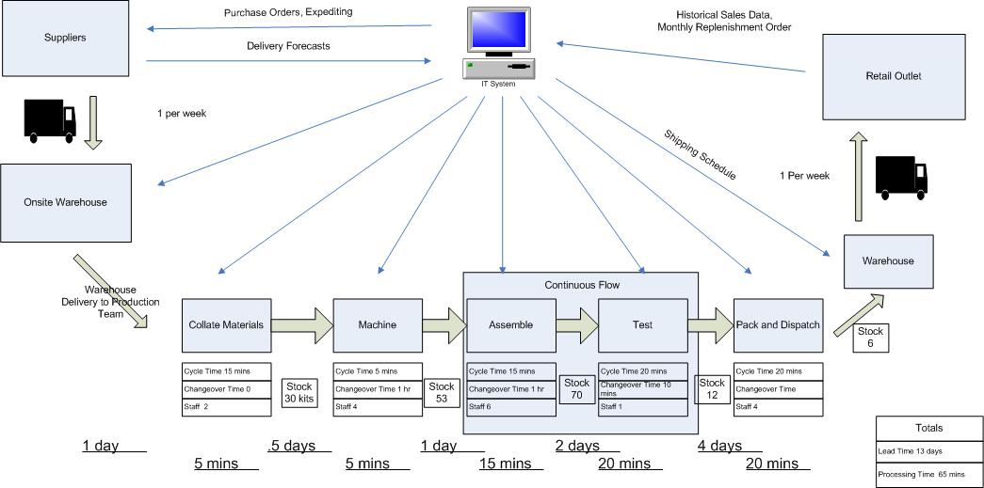
Flow
Diagram from Bizbodz.com at
http://www.bizbodz.com/Business-Improvement/Lean/Value-stream-mapping-how-to-guide-part-2.asp
Notes:
FLOW –
Value stream mapping – used to evaluate any process
Key concepts:
Sustainable pace
Minimize inventory
Eliminate waste
Lagging stories
Defects
Idle time
-------------------------------------------------------------------------------------------------------------
Managing the Process
Flow
The basic principle of flow is that the goal is to minimize inventory and other forms of waste, keep the process moving at a consistent pace, reduce the amount of wait time (another form of waste), and ensuring that “products” move from one end to the other smoothly.
Signs of waste, or of the process working ineffectively, include stories that stay in place for a long time, lots of defects, stories moving backward, and team members who have idle time.
Graphic?
Retrospectives
Discussion: retrospectives as a tool for continuous improvement and for communication.
Retrospective
* Frame: Team members sitting around a table, paper on the wall with stickies on it – maybe a starfish (see below)?
Planning Meetings
Discuss release planning and iteration planning meetings.

Slide 18
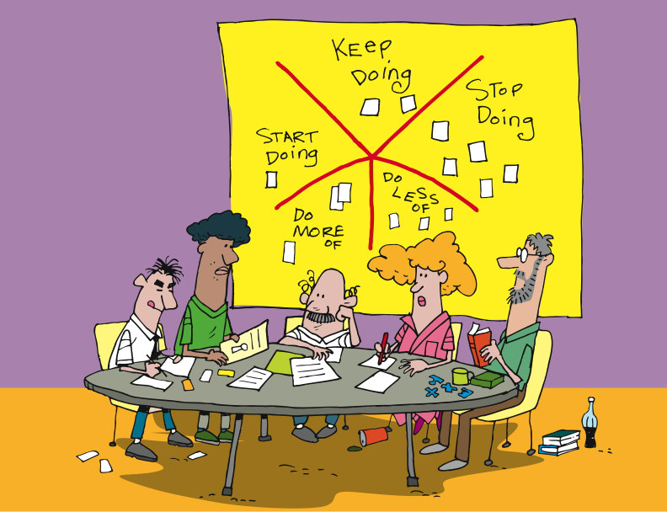
Retrospectives
“Whether you are using Agile methods or more traditional incremental or iterative development, your team has an opportunity to reflect at the end of every increment and identify changes and improvements that will increase the quality of the product and the work life of team members.”
Esther Derby and Diana Larsen
“…a well-run retrospective can help members of a community understand the need for improvement, and motivate them to change how they go about their work.”
Norm Kerth
http://www.thekua.com/rant/wp-content/uploads/2006/03/StarTechnique.gif
Notes:
Rodin, the artist, said
“Nothing is a waste of time if you use the experience wisely.”
Oscar Wilde said
“Experience is the name everyone gives to his mistakes.”
[CLICK]
Norm Kerth – 2000 – ‘Project Retrospective’ [CLICK]
Esther Derby and Diana Larsen – 2006 - wrote the book “Agile Retrospectives: Making Good Teams Great”.
[CLICK]
At the end of each Iteration, Release
Starfish model – Patrick Kua – TW
Review the model
Action items
Reduce waste, constant improvements
What’s the purpose of having a retrospective? It should be:
Informative – Communicate “the story” to all
Enlightening – Capture data, metrics or collective wisdom gained from the project
Progressive – Improve process/management/culture
Cathartic – Repair damage to the team or allow the team to enjoy what’s been accomplished
-----------------------------------------------------------------------------------------------------------
Rodin, the artist, said “Nothing is a waste of time if you use the experience wisely.”
Oscar Wilde said “Experience is the name everyone gives to his mistakes.”
And Kierkegaard said “Life can only be understood backward, but it must be lived forward.”
In 2001, Norm Kerth wrote the book “Project Retrospectives,” in which he said [CLICK] “a well-run retrospective can help members of a community understand the need for improvement, and motivate them to change how they go about their work.”
Following in Kerth’s footsteps, in 2006 Esther Derby and Diana Larsen wrote the book “Agile Retrospectives: Making Good Teams Great”. In their book, Esther and Diana said [CLICK] “Whether you are using Agile methods or more traditional incremental or iterative development, your team has an opportunity to reflect at the end of every increment and identify changes and improvements that will increase the quality of the product and the work life of team members.”
[CLICK] Agile teams generally include retrospectives as one of their practices. While different teams make different choices, it’s most common for teams to do retrospectives at each milestone – that is, at the end of each Iteration, Release, and at the end of the Project. We recommend Derby and Larsen’s book “Agile Retrospectives” as a key component of your team’s library. The activities and guidance in this book are priceless.
The goals of retrospectives, as stated by Kerth and Derby and Larsen, are to use the past – our experience – to improve our future. Whether it’s team functioning and communication – focused on the people – or technology, architecture, and technical practices, the goals are the same – learn and improve.

Slide 19
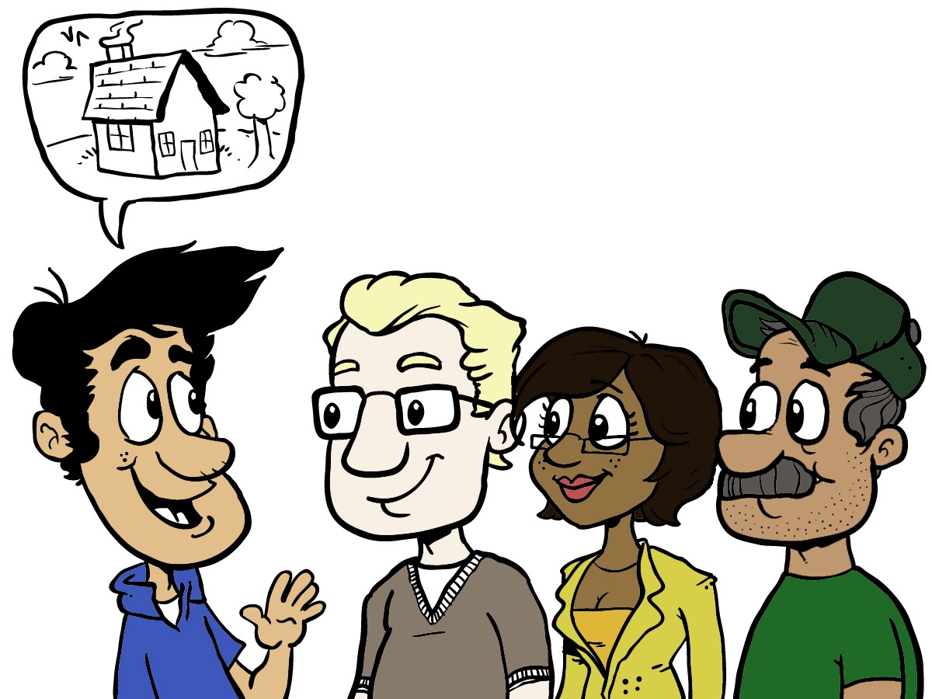
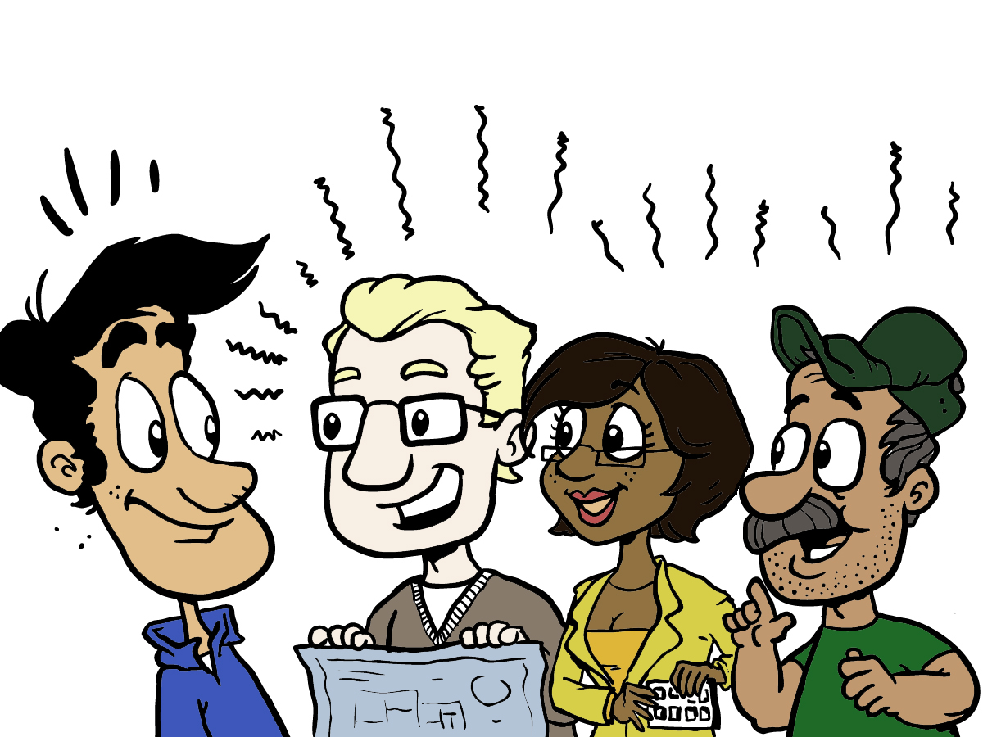
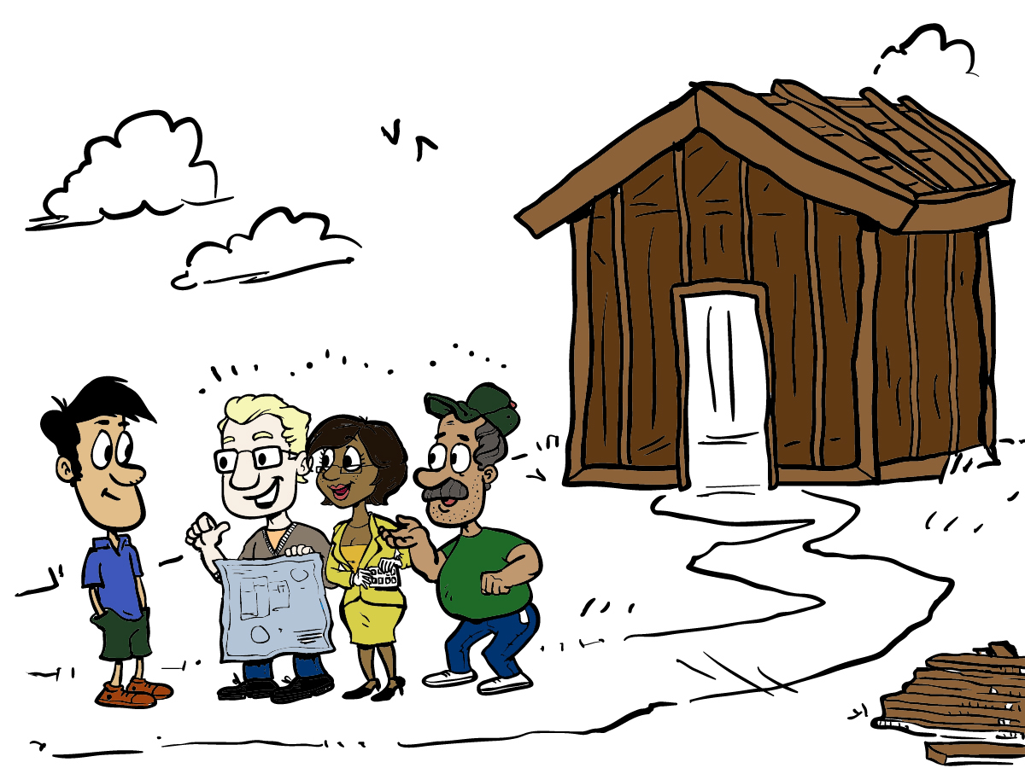
Planning Meetings
Notes:
Begin each increment with a planning meeting [CLICK]
Project
Release
Iteration
Project planning – initial project definition and priorities
Release Planning – stories for the next release, prioritize, estimating
Iteration Planning – stories for the next iteration, tasking, estimating
-------------------------------------------------------------------------------------------------
At the beginning of each increment [CLICK] – Project, Release, or Iteration – there is planning to be done. We have to understand what we’re building, what we expect to get done in this period, and what our expectations are at the end of the period.
Project planning meetings involve [CLICK] the definition of the product and initial priorities.
Release planning meetings [CLICK] involve choosing, estimating, and prioritizing the stories to be implemented in this release. You may remember we talked about vertical slices and story mapping. These practices are generally applied during Release Planning so that the Release delivers the best defined value.
Iteration planning meetings [CLICK] determine which of the stories selected for the Release will be implemented during the next Iteration. These are the meetings where we refine our understanding and estimates of each story, as necessary, to ensure that we do not overcommit or undercommit, and so that we are clear about the value to be delivered.

Slide 20
BA Huddle
Signoff
Escalation
Priorities
Narratives
Testing
Usability
Schedule
Regression
Risks
Staffing
Performance
SWAT
BA Lead
Timeline
Project
Sponsor
QA
Lead
Automation
Project Manager
Teams
Iteration
Managers
Product
Mgr
Scope
Progress
Priorities
Staffing
Risks
Architect
Tech Huddle
Vision
Features
Forecasts
Estimates
Technical
Debt
Risks
Test
Coverage

Slide 21
Cross Team Communication
Team 1 Iteration Manager | Team 2 Iteration Manager | Team 3 Iteration Manager | IM Huddle
Tech Lead | Tech lead | Tech Lead | Tech Huddle
Business Analyst | Business Analyst | Business Analyst | BA Huddle
Tester | Tester | Tester | QA Huddle
Developer | Developer | Developer | Learning Lunches and Patterns

Slide 22
In Summary
Iterative and Incremental
Chicken and Pigs
Daily standups
Collocated teams
Flow
Retrospectives
Planning meetings
Team structure
Cross team communication

Slide 23
Maintaining Visibility and Communications
Notes:
Accurate visibility into project progress has traditionally been a problem
Agile address this by making project status extremely visible to everyone
----------------------------------------------------------------------------------------------------------------
One of the exciting and powerful aspects of Agile is the free flow of information and communication. This is true both within an Agile team, and between the team and the rest of the organization. Agile teams talk about transparency, meaning that facts and information are freely available at all times, and that our successes and failures are equally visible.

Slide 24

Information Radiators
Notes:
Static sources of information available to anyone who chooses to view them.
No request needed
Always updated and ready to view [CLICK]
Standard ones [CLICK]
Custom ones
----------------------------------------------------------------------------------------------------
One of the tools for this communication and transparency is a category of things that we refer to as “information radiators”.
[CLICK]
Information radiators are static sources of information that are available to anyone who chooses to view them. By “static” we mean that there is no request needed and no specific interaction (although we’ll get back to this when we talk about Mingle). Rather, information radiators provide information simply by viewing them. Examples [CLICK] are the card wall and the burn-up chart which we touched on briefly a bit earlier in this module. The card wall is always there, and anyone can look at it and learn the state of the project, release, or iteration.

Slide 25
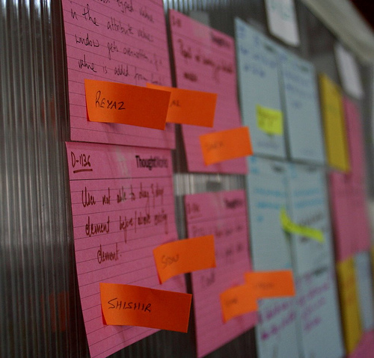
Story walls
Simplicity
Use color
Physical or electronic
Source: http://www.flickr.com/photos/karthikc/333796870/
Notes:
The power of a story/card wall comes from it’s simplicity and lo-tech nature. Fundamental to the success of a story wall in quickly conveying iteration status is the ability to easily pick out the salient details and the ease of it’s maintenance.
Place too much information into a story wall and easy-of-understanding is lost.
Place too much process around the updating and ease-of-use is lost.
story walls can be varied in several ways to enhance effectiveness:
Use color to denote type (e.g. split by story/task, business area, front/back end)
Use color to denote specialty required, or some other detail
Use red sticky dots to denote blocked stories; use other colored sticky dots for other informational purposes
Use pictures of team members and attach them to stories that are in progress so the team can see at a glance who is working on what story
Use size to denote size of estimate
Add initials to indicate who is working on the card
Physical wall vs electronic wall
Can’t close the browser on a physical wall
Can use colors to reflect different types of cards
Can use keys to identify blocked cards
Low: 2 min
High: 4 min
Original text:
BVC showing progress of stories through iteration
Usually group stories by what role is currently working on (‘owns’) them
‘Ready’, ‘Planned’, ’In Progress’, ‘In Testing’, ‘Done’
But use whatever arrangement makes sense for your project

Slide 26
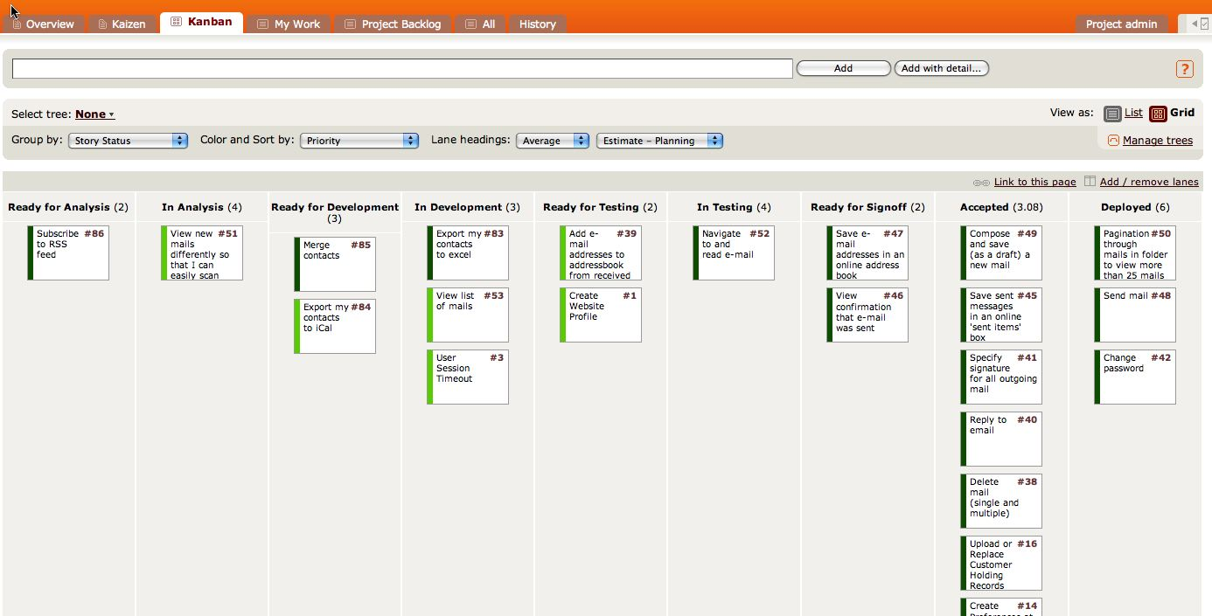
The Card Wall
Notes:
Card wall is in the team room
Easily accessible and visible
Mingle example [CLICK]
Not methodology dependent – scrum, lean, xp
Single iteration
Showing state of the card [CLICK] Ready for Analysis to Deployed
Some cards in next iteration – Analysts typically work iterations ahead of development
Clearly see the status of the iteration [CLICK] [CLICK]
--------------------------------------------------------------------------------------------------------
We’ve talked about the card wall throughout this course. Let’s look at it again, and an example of a card wall in Mingle.
[CLICK] It’s hard to overstate the value of the card wall. Regardless of the approach you follow – Scrum, XP, or Lean, for example – there is a card wall, and the value of it lies in its ability to communicate so clearly and completely, requiring little effort on the part of the reader.
Here’s an example of a representation of a card wall in Mingle. As you can see, this card wall is focused on a single Iteration, covering states [CLICK] from Ready for Analysis to Deployed. In many cases, the stories in the Ready for Analysis and In Analysis states are actually being prepared for the next Iteration. The work of Business Analysts is generally an Iteration ahead of the rest of the team, allowing them the time they need to figure out details and acceptance criteria so that the stories will be ready for the development team.
As you can see here, it’s easy to understand the state of the work being done in an Iteration on the card wall. For instance,[CLICK] we can see that there are a number of stories on which the work is complete that are waiting to be deployed. At the other end, [CLICK] there are a couple of stories that are ready for development, [CLICK] a few in development, and so on. Without even looking at the specific stories, [CLICK] we can learn a great deal about the project just by seeing the flow of work through viewing the card wall.

Slide 27
Planned for Iteration
Ready for Dev
In Dev
Ready for Testing
In Testing
Awaiting sign-off
Done
D
A
C
G
B
E
F
H
When a story arrives here, it’s ready for elaboration.
Notes:
The basic way of reading a story wall is left-to-right.
Cards should move from left to right (and hopefully only in that direction) as they progress through the analysis/development/testing pipeline and into a state where they can be deployed.
For many teams, the top to bottom order is also indicative of the priority of the stories, although this information can be written on the cards as well if needed.
The BAs are working on these stories
These stories are likely for the next iteration.
Should you move these over, when ready for development? Depends on team preference.

Slide 28
Planned for Iteration
Ready for Dev
In Dev
Ready for Testing
In Testing
Awaiting sign-off
Done
D
A
C
G
B
E
F
H
When a story arrives here, it’s ready for development
Notes:
Developers pick up stories from the column.
These stories have been analysis, design, and have acceptance criteria.
Its OK that there is nothing in ‘in testing’ and ‘awaiting signoff’. These folks are working on story elaboration for the next round of stories.
Once a story has been scheduled and elaborated, it will wait for a developer to pick it up. There’s little value in amassing a huge number of elaborated stories if the developers’ won’t be able to work through them all within the iteration. It may seem like this approach allows the team to “get ahead in elaboration”, but the risk of requirements changes making the elaborated stories unsuitable is very real and this reason should temper any efforts to optimize the process for one column of the story wall only.

Slide 29
Planned for Iteration
Ready for Dev
In Dev
Ready for Testing
In Testing
Awaiting sign-off
Done
C
A
G
D
B
E
F
H
When a story arrives here, it’s ready for testing.
Notes:
Testers pick up stories from this column.

Slide 30
Planned for Iteration
Ready for Dev
In Dev
Ready for Testing
In Testing
Awaiting sign-off
Done
A
G
D
E
C
F
B
H
When a story arrives here, it’s ready for customer sign-off.
Notes:
Customers or Product Owners can see clearly any stories that require signoff before deployment.
Backups in this column are common.

Slide 31
Planned for Iteration
Ready for Dev
In Dev
Ready for Testing
In Testing
Awaiting sign-off
Done
D
E
A
G
C
F
B
H
When a story arrives here, it’s done.
Notes:
Completion of a story is based on acceptance from the developer, the tester and the customer or customer proxy. If the transition from a developer’s machine to a testing environment is a time consuming one (not ideal), then the sign off process to put a story into the “Done!” column can be performed at a developer’s desk, with the Customer (or Proxy) and Tester being called over for sign-off.
For a moderately experienced Agile team, the story wall should contain enough information that no-one need ask the IM or PM what to work on next – it should all be obvious from the story wall, or from conversations with the people responsible for the various columns. A card arriving in a new column should be an immediate trigger to the people responsible for that column that new word has arrived, assuming they have capacity to do the work. For novice teams, the IM may need to take a sterner hand in allocating work. Some teams may also decide to fully allocate work during the IPM. In practice, this approach can lead to a lack of flexibility.

Slide 32
When is a story done?
Developer Complete
Customer Acceptance
Testing Verification
Done!






Notes:
In short, a story can be considered done when its:
Coded
Meets coding standards
Tests are included in the automated tests
Passed through the build
Verified in a trusted environment by the customer… with advice from the tester(s)
The whole team should work on reducing this cycle time
It is vital that neither the PM nor IM bows to pressure (either internal or external) to skimp on any of these steps (usually the latter 2) in order to “fake” completion of stories. Although they may get away with it in the short term, it increases the risk of poor quality software being considered “done” and will result in significant delays when these processes are commenced again later in the project. Enforced overtime to complete stories or extending iteration length to include “almost finished” stories is another example of gaming the system to provide a false sense of heightened velocity. The best thing project management can do is get an accurate picture of the team’s velocity under sustainable working conditions and use that for forward planning.
Low: 2 min
High: 3 min

Slide 33
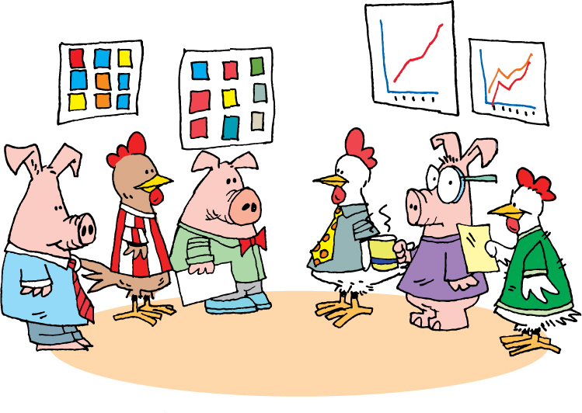
Daily Stand-Up
Notes:
Daily standup is important to visibility and communications
Communication flow is daily at a minimum
Minimal lags in work
Chickens can learn about day-to-day by attending
------------------------------------------------------------------------------------------------------------------
While we’ve talked about it before, it’s important to come back to Daily Stand-Ups again in the context of Visibility and Communications.
There are a number of goals accomplished by holding daily stand-ups.
Doing them daily means that the communication flow is consistent. It also means that there are minimal lags – we all know what we’re all doing very immediately, without having to wait for status reports. It also means that others – managers, stakeholders – can learn about what’s going on day-by-day by attending a daily standup. That assumes that the team gives permission for others to attend, of course.

Slide 34
Stand up role play
Preparation
Everyone gets a card with a role that they will play during standup
Objective
Playing your role, you should say……
What you had for dinner last night
What you intend to have for dinner tonight
Any obstacles
Notes:
Learning objectives:
Using a talking token keeps everyone paying attention as the token could come to them next
Using a token also keeps people from talking over each other. Only the person with the token can talk
Anyone can stop rambling or someone who isn’t following the format.
Talk to the group, not the IM

Slide 35
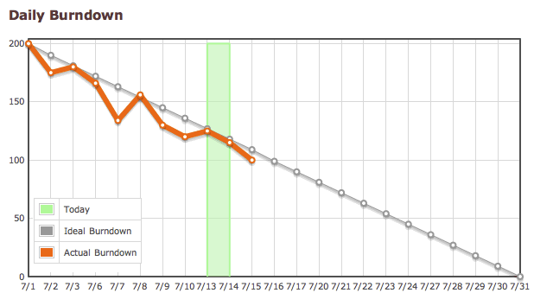
Reporting Progress – Burn Down
Notes:
2 primary radiators – Burn up and burn down
Comes directly from SCRUM
Same info in slightly different format
What we have to do [CLICK]
And when we are done [CLICK]
Release and/or iteration level charts
---------------------------------------------------------------------------------------------------
There are two primary reports that are used by Agile teams: the Burn Down chart, and the Burn Up Chart. The Burn Down chart comes directly from Scrum. Both charts represent the same information, fundamentally, but in a slightly different presentation.
The Burn Down chart approach is to start with the assumption that we know how much work we have to do [CLICK], and that we know we’re done when there’s nothing left to do [CLICK]. This is used for release level reporting, and is based on the practice of identifying all stories to be done during this release, and assuming that there will be no changes. While it is adaptable, and can accommodate changes in scope, it is not as clear, in our estimation, as…

Slide 36
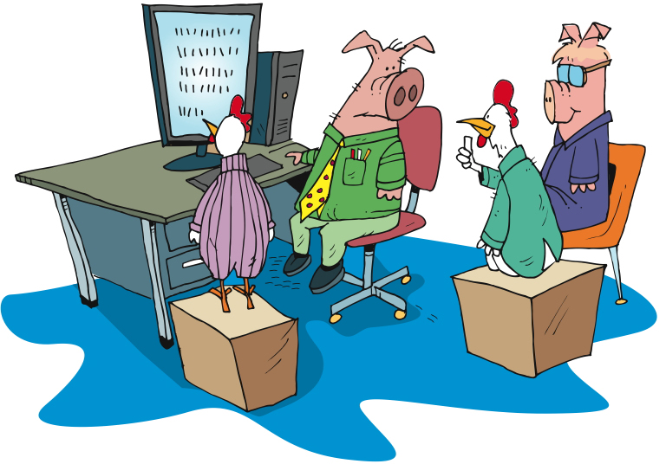
Showcases
Notes:
Goal - Working software at the end of each iteration
Showcase at the end of each iteration
Not design session or brainstorming
We do get feedback
Feedback may turn into new stories
For the chickens
-------------------------------------------------------------------------------------------------
With the goal of ensuring that information and knowledge are spread throughout team and stakeholders, and that the team gets valuable feedback as early as possible, we follow each Iteration with a showcase.
During the showcase, we show what has been done during the Iteration just completed. This is not a design session, nor a brainstorming session. The purpose of the showcase is to say “here’s what we’ve gotten done” and to solicit input from the participants. It is not unusual for additional stories to be generated as a result of the showcase, as stakeholders gain a greater understanding of what is actually being delivered and the value that goes with that.
This is not to say that we don’t share what we’re doing prior to the showcase. It’s that the showcase is the time when we say “this is what we’ve gotten done” and actively seek feedback from stakeholders who are not normally involved on a daily basis – the Chickens.

Slide 37
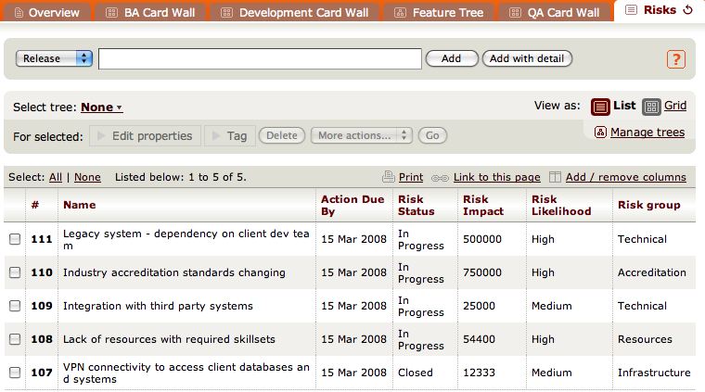
Managing Risks and Issues
Notes:
Not unique to Agile – Risk and issue tracking
The many additional ways to identify risk
Showcases
Customer collaboration
Daily standups
Planning meetings
Mingle risk tracking example
---------------------------------------------------------------------------------------------------------------
We’re almost there!
Every undertaking has risks and issues. Risks are forward looking – things that might happen. Issues are backward-looking – things that have happened.
Agile teams make every effort to identify risks – things that could get in the way of successfully completing the project. When possible, mitigation strategies will be identified and put in place. This means that we might be able to avoid the risk if we take the right steps. On the other hand, some risks cannot be avoided – they will become issues, it’s just a matter of when. However, by thinking them through and identifying them in advance, we can be far more prepared.
We record risks and issues so that we can be sure not to lose the benefit of the thinking that went into the process. On this slide, you see a risk log being maintained in Mingle.
Whether you use Mingle, Excel, or a card wall to record and track your risks and issues, record and track them you must.

Slide 38
Agile Best Practices
Automated
Build/Deploy
Short
Releases
Pair
Programming
IKO/IPM
Retrospectives
Automated
Testing
Card Wall
Refactoring
Daily
Stand-ups
Collective
Ownership
Simple Design
Coding
Standards
Velocity
Metrics
Iterations
Co-location
Test Driven
Development
User
Stories
Sustainable
Pace
On-site
Customer
Continuous
Integration
INDIVIDUAL
TEAM
ORGANIZATIONAL
Notes:
Review and ask if there are any questions about any of the concepts.

Slide 39
In Summary
Inputs
Capacity
Story Lifecycle
Outputs

Slide 40
Metrics
What is most important to you?
Progress indicators
Team collaboration
Quality
ROI

Slide 41
Big Visible Charts
Big
Easier to comprehend from a distance
Visible
To the core team
To any stakeholders walking by!
Chart
Low-tech
Whiteboard + pen
Butcher’s paper
Focus on key project metrics
Don’t force people to search for information
Don’t be afraid to highlight issues
Notes:
The best known example of the BVC is the burn up or burn down chart, but many others exist as well.
As with story walls, the key to successful use of BVCs is keeping them simple enough to update that they won’t fall out of date due to people not being bothered battling process or tooling to do the update needed. Adding a new data point by hand to a butcher’s paper graph is much easier than adding a new value to an Excel equivalent and then printing it out in A0 format or having it professionally enlarged.
The other trap people fall into with BVCs is overkill. If every wall is covered with a BVC of some kind or another, they will blend into the scenery and loose their value. Choose BVCs for the most important things to highlight only.
Low: 1 min
High: 3 min
Original Title: Big Visible Charts/Information radiators

Slide 42
Burn up charts: predicting progress
Notes:
When might this Release finish?
--------------------------------------------------------------------------------------------
Here we show how you can extrapolate a team’s velocity and extend the expected scope and take a stab at when the project might finish (i.e., where the two lines meet). Be careful at what point you start this extrapolation as team velocity will waver significantly during the start of a project so a straight average velocity taken across the first couple of iterations will produce poor data for planning. Many teams used weighted averages with more weight being given to the later velocities as a better predictor of how the team is tracking.
Other options are the “average of best three iterations” and “average of worst three iterations” to derive either optimistic or pessimistic schedules.
Low: 1 min
High: 2 min
Original title: Burn up charts: extrapolating progress

Slide 43
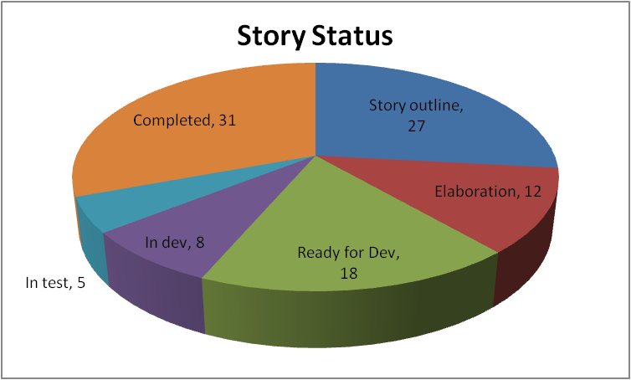

Slide 44
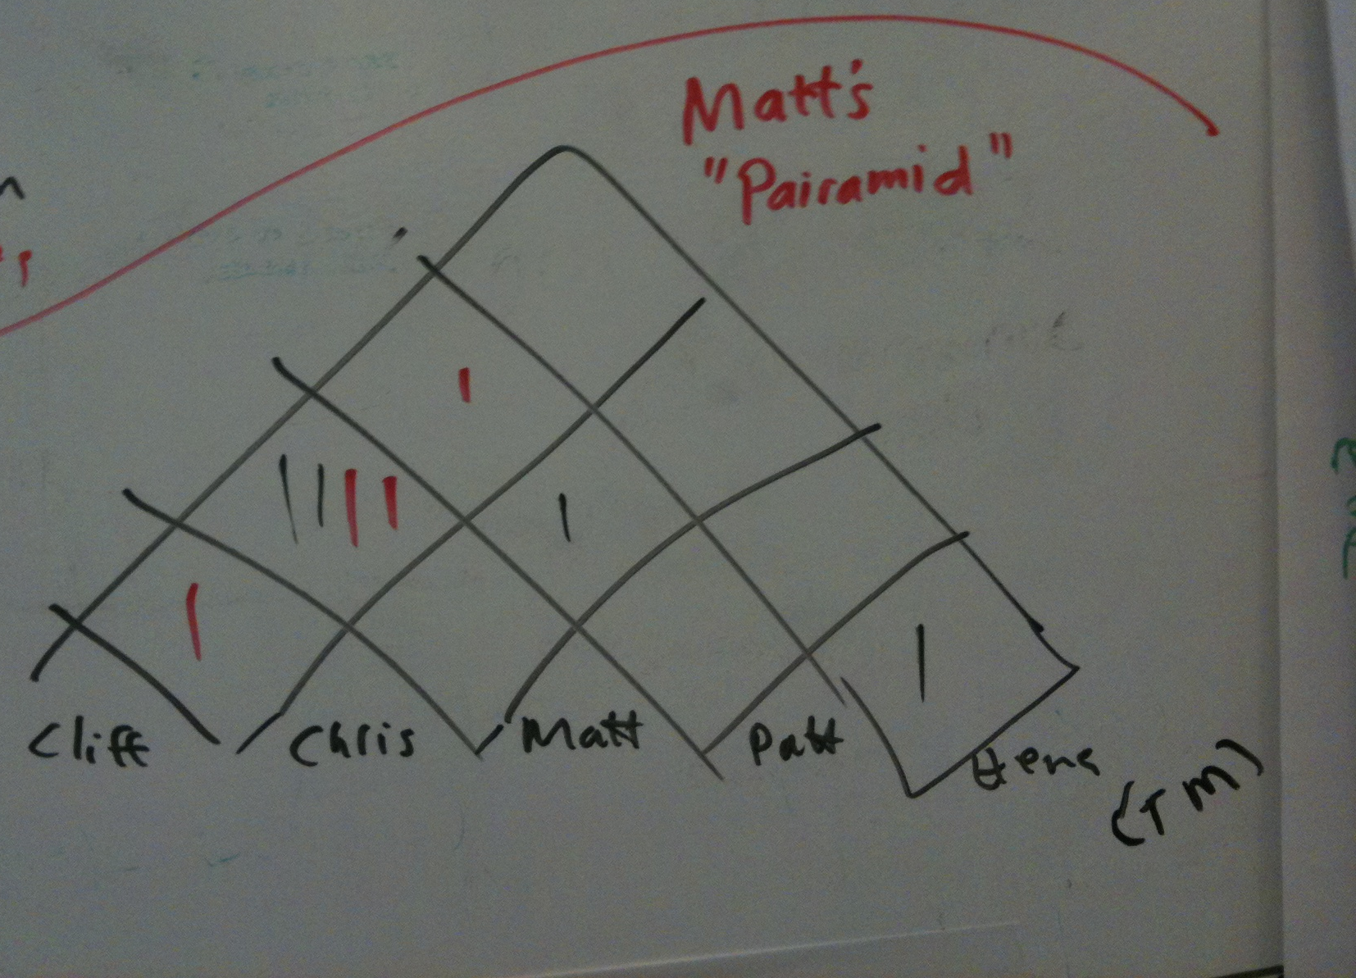
Pairing
Notes:
This BVC is obviously low tech.
It is from one of our trainers, Matt Philip.
Used to monitor pair changing.
Use a different color for each day of pairing.
For example – shows Cliff and Matt pairing 2 x on Mon and 2x on Tues.

Slide 45
Test Cases

Slide 46
Running Tested Features (RTF)
Stories Passing Test
Iteration

Slide 47
Module Showcase
Learn how to manage the work
Understand the different types of meetings
Learn about the flow of the iteration
Understand how to use information radiators

Slide 48
Questions?

